Slide 1
Learning to Augment Graph Data
Meng Jiang
Department of Computer Science and Engineering
University of Notre Dame

Slide 2
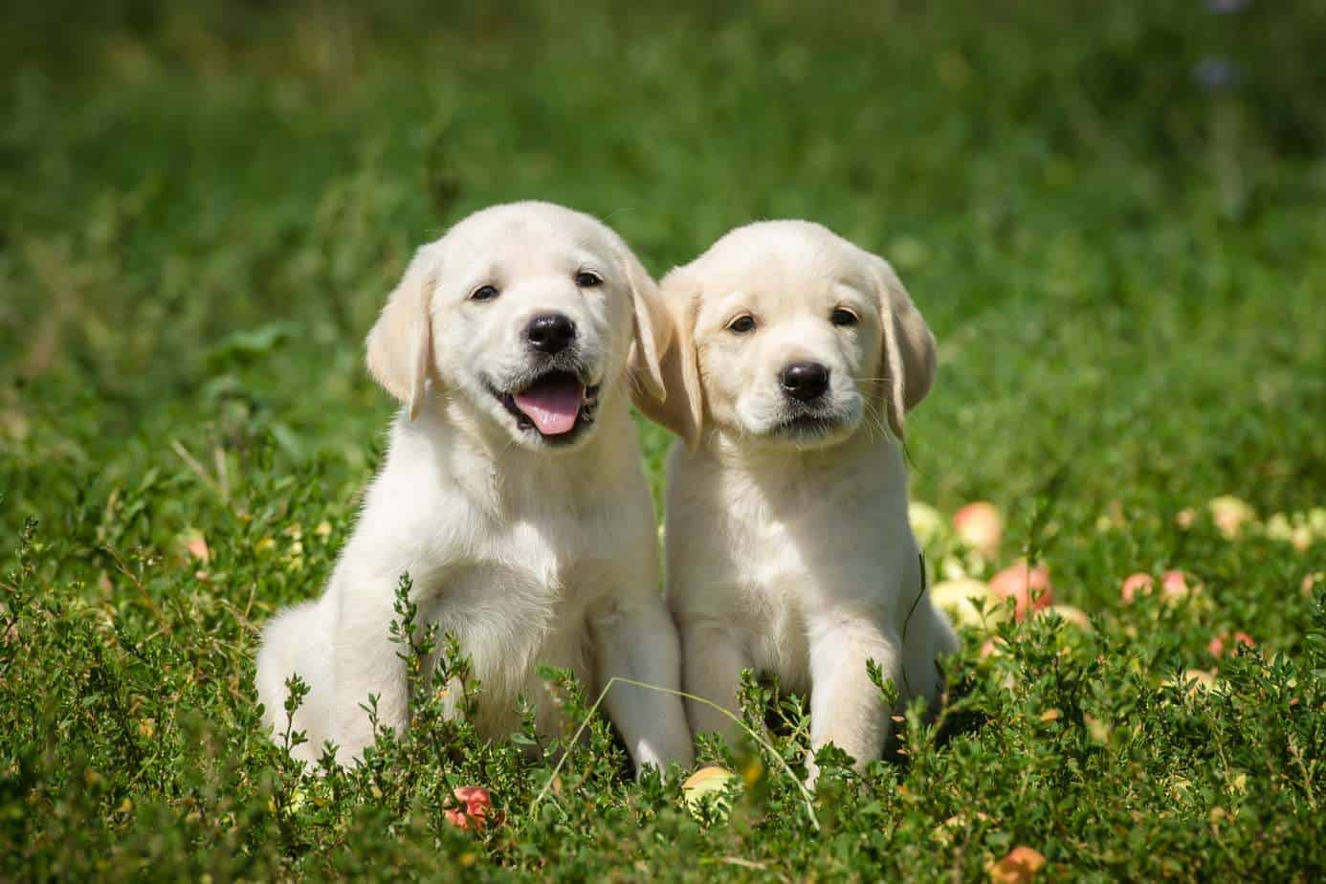
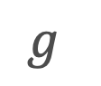

Data Augmentation
from Wikipedia
Techniques used to increase the amount of data by adding slightly modified copies of existing data or newly created synthetic data from existing data.
It helps reduce overfitting when training a machine learning model.
Model
$$f$$
$$g$$
augment
Representations
“dog”
Extra data points
?

Slide 3
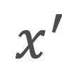



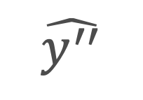


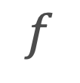

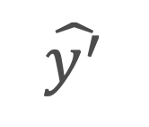
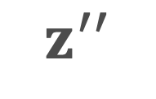
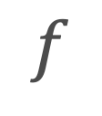
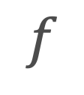
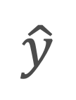
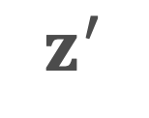

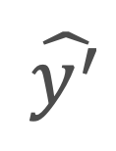
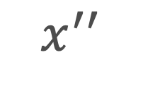


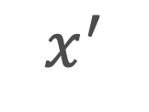
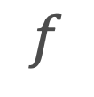
Data Augmentation
for Different Training Objectives
Supervised Learning
Self-supervised Learning
augment
augment
$$x$$
augment
$$x$$
$$x^{′}$$
$$x^{′}$$
$$x^{′′}$$
$$f$$
$$f$$
$$f$$
$$f$$
$$z$$
$$z^{′}$$
$$z^{′}$$
$$z^{′′}$$
$$g$$
$$g$$
$$g$$
$$g$$
$$\hat{y}$$
$$\hat{y^{′}}$$
$$\hat{y^{′}}$$
$$\hat{y^{′′}}$$
loss
loss
loss
$$y$$

Slide 4
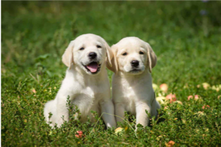
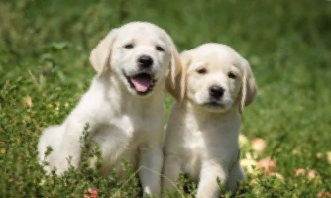
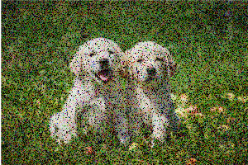
Image Data Augmentation
Cropping
Flipping
OpenCV
Rotation
Add noise
Shorten et al. “A survey on image data augmentation for deep learning.” Journal of big data 6.1 (2019): 1-48.
Zhong et al. “Random erasing data augmentation.” AAAI 2020.

Slide 5
Text Data Augmentation
WordNet
“It is amazing.”
“It is awesome.”
synonyms
“amazing”
“awe-inspiring”
“awing”
…
Wei et al. “EDA: Easy Data Augmentation Techniques for Boosting Performance on Text Classification Tasks.” EMNLP 2019.
Liu et al. “A survey of text data augmentation.” IEEE CCNS 2020.
Sun et al. “Mixup-Transformer: Dynamic Data Augmentation for NLP Tasks.” ACL 2020.

Slide 6
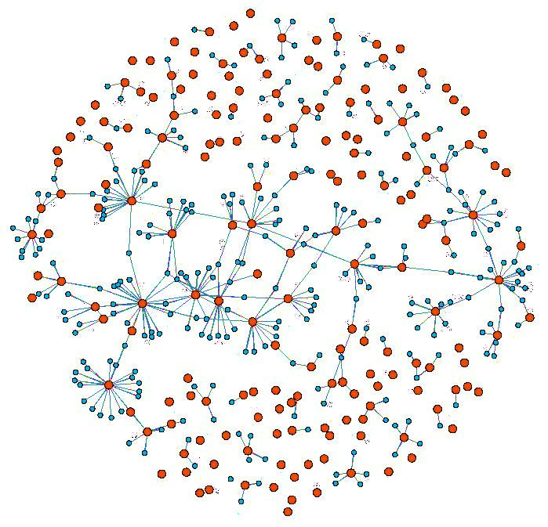
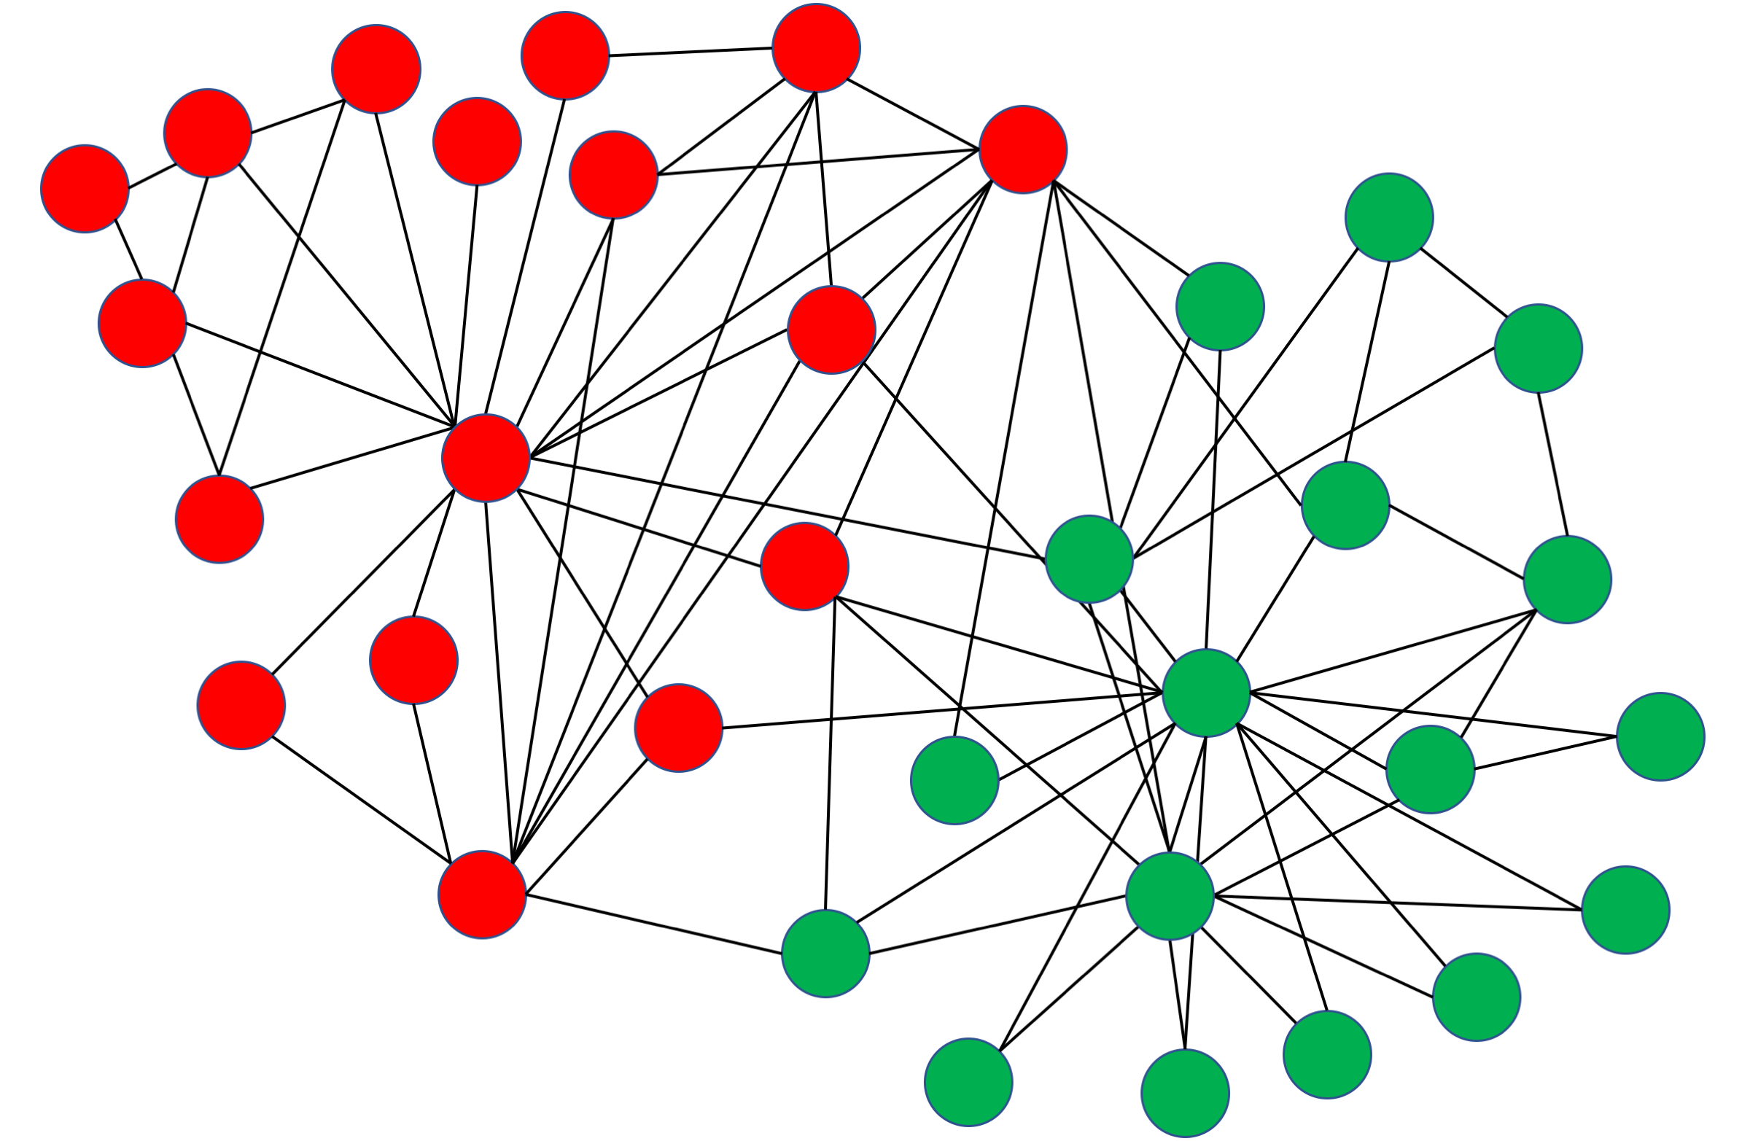
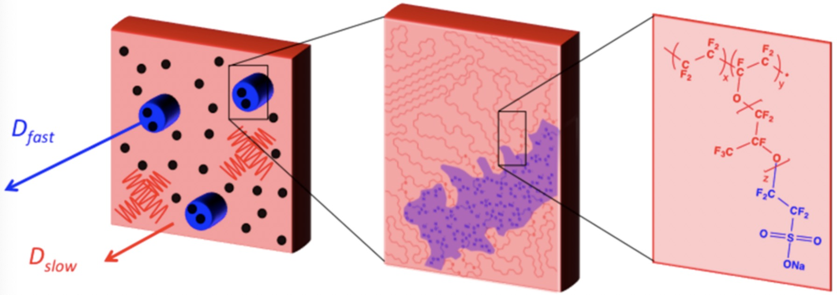
Graph Data and Tasks
Three Different Types
Node-level tasks: Node classification and regression
Link/Edge-level tasks: Link prediction and relation prediction
Graph-level tasks: Graph property prediction
Polymer (macromolecule) membrane
Network Science
Social networks
Recommender systems
Material Science
Gas permeability and separation

Slide 7
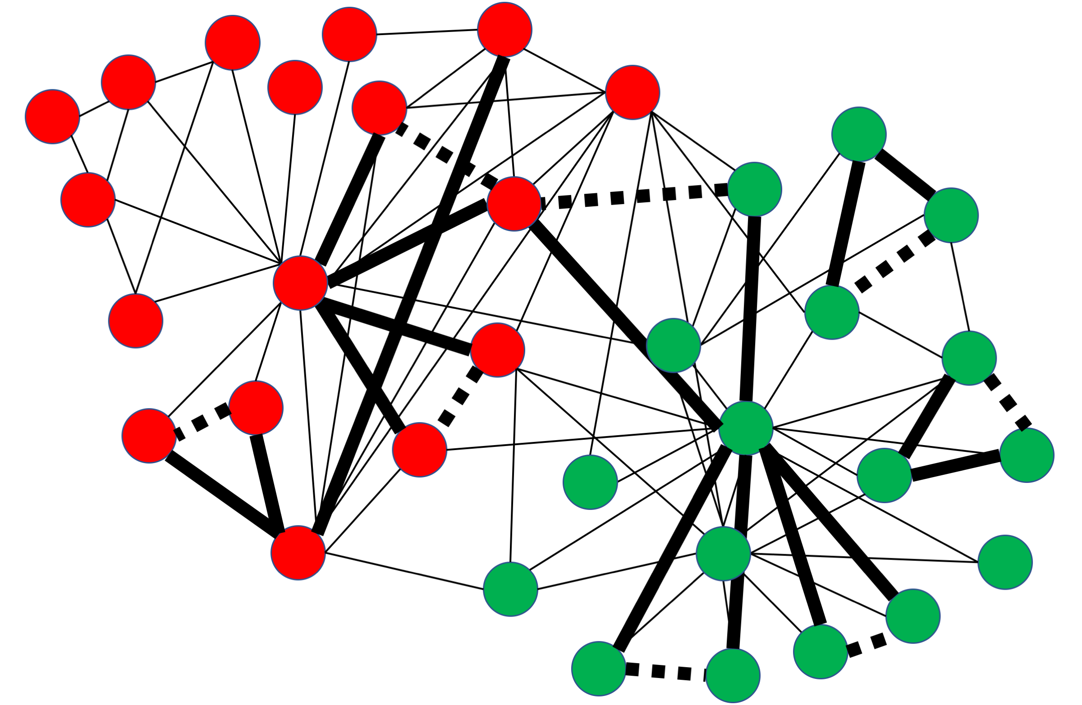
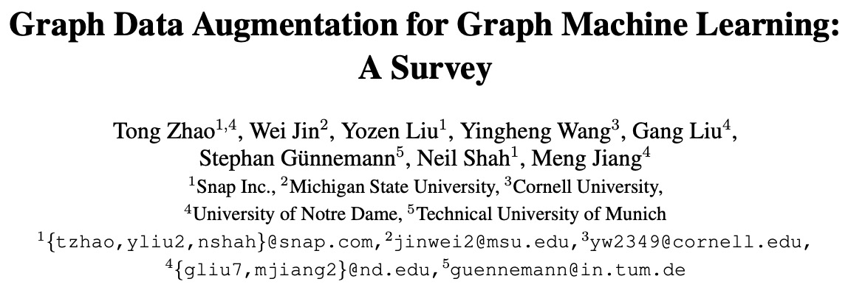
Graph Data Augmentation
Common Heuristic Methods
Node augmentations: Drop nodes, etc.
Edge augmentations: Drop edges, etc.
Feature augmentations: Mask features, etc.
Subgraph augmentations: Crop subgraphs, etc.
Connect 2-hop neighbors
Add a virtual node that
connects to all
https://arxiv.org/pdf/2202.08871.pdf
Klicpera et al. “Diffusion improves graph learning.” NeurIPS 2019.
Feng et al. “Graph random neural networks for semi-supervised learning on graphs.” NeurIPS 2020.
You et al. “Graph contrastive learning with augmentations.” NeurIPS 2020.

Slide 8
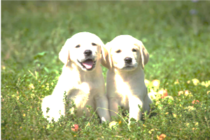
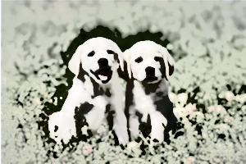
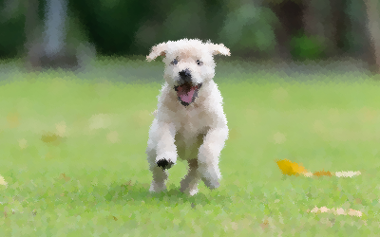
Learning to Augment Data
Machine Learning rather than Heuristics
Learning to create effects
Learning to erase or generate
Fawzi et al. “Adaptive data augmentation for image classification.” ICIP 2016.
Li et al. “On feature normalization and data augmentation.” CVPR 2021.

Slide 9
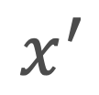
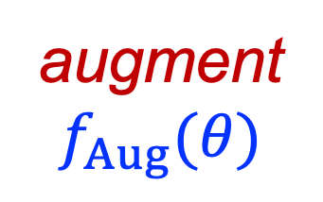
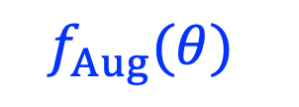





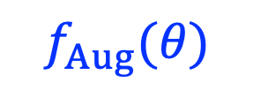



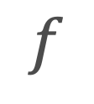
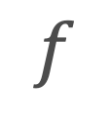

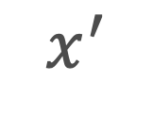

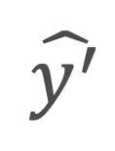




Learning to Augment Graph Data
Supervised Learning
Self-supervised Learning
augment
$$f_{Aug}(θ)$$
augment
$$x$$
augment
$$x$$
$$x^{′}$$
$$x^{′}$$
$$f_{Aug}(θ)$$
$$f_{Aug}(θ)$$
$$x^{′′}$$
$$f$$
$$f$$
$$f$$
$$f$$
$$z$$
$$z^{′}$$
$$z^{′}$$
$$z^{′′}$$
$$g$$
$$g$$
$$g$$
$$g$$
$$\hat{y}$$
$$\hat{y^{′}}$$
$$\hat{y^{′}}$$
$$\hat{y^{′′}}$$
loss
loss
loss
$$y$$

Slide 10
Learning to Augment Graph Data
Introducing Four Novel Methods
Can we augment a large graph for node classification?
How should we augment the large graph for link prediction?
Can we augment behavior metadata for anomaly detection on a graph?
Can we augment graph data points for graph property prediction?

Slide 11
Learning to Augment Graph Data
Introducing Four Novel Methods
Can we augment a large graph for node classification?
How should we augment the large graph for link prediction?
Can we augment behavior metadata for anomaly detection on a graph?
Can we augment graph data points for graph property prediction?

Slide 12




Data Augmentation for Graph Neural Networks
Virtual
The 2021 AAAI Conference on Artificial Intelligence
Tong Zhao, Yozen Liu, Leonardo Neves, Oliver Woodford, Meng Jiang, Neil Shah

Slide 13


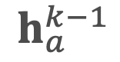

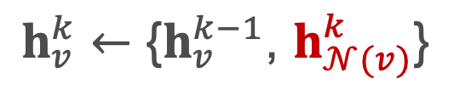


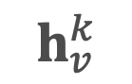

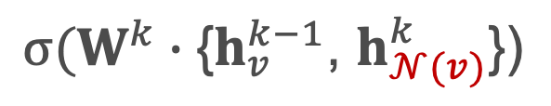
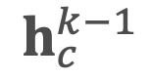
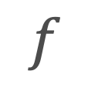
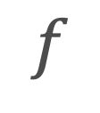
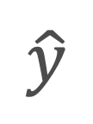
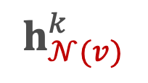
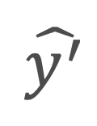
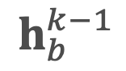


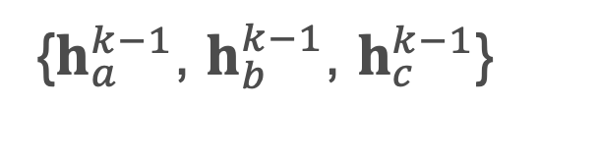
Graph Neural Network for Node Classification
Your neighbors define you!
augment by changing neighbors$𝒩(v)$
$$h_{a}^{k−1}$$
$$v$$
$$v^{′}$$
$$f$$
$$f$$
$$h_{v}^{k}←\text{\{}h_{v}^{k−1}\text{, }h_{𝒩(v)}^{k}\text{\}}$$
$$z$$
$$z^{′}$$
$$h_{c}^{k−1}$$
$$g$$
$$g$$
$$h_{b}^{k−1}$$
$$\hat{y}$$
$$\hat{y^{′}}$$
{$h_{a}^{k−1}$, $h_{b}^{k−1}$, $h_{c}^{k−1}$}
AGGREGATE_{k}
(e.g., max pooling, mean, LSTM)
$$h_{𝒩(v)}^{k}$$
loss
loss
$$σ(W^{k}∙\text{\{}h_{v}^{k−1}\text{,} h_{𝒩(v)}^{k}\text{\}}\text{)}$$
CONCAT, NON-LINEAR,
WEIGHT MATRICES
$$h_{v}^{k}$$
$$y$$

Slide 14
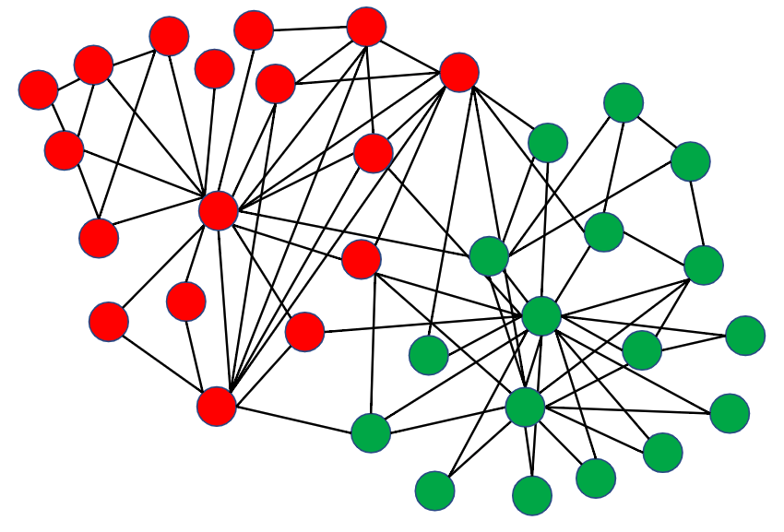
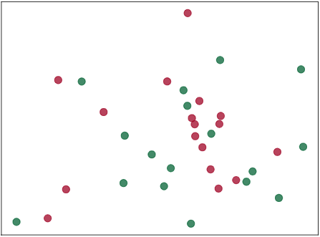
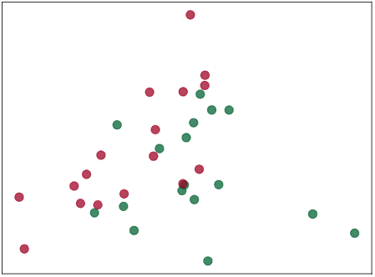
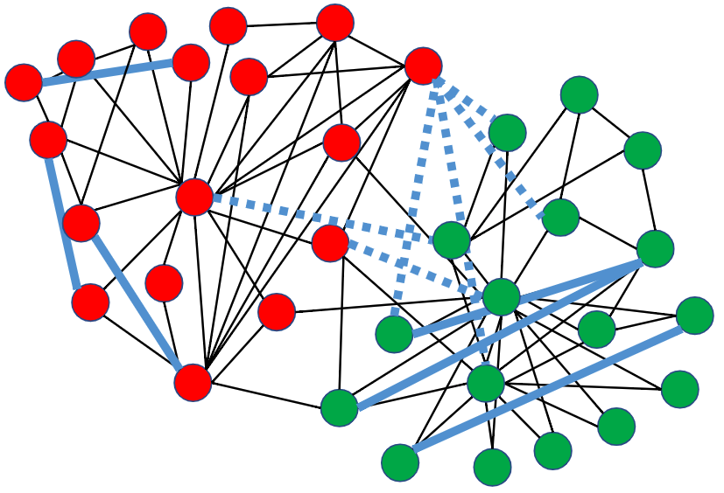


What$𝒩(v)$ improves $z$?
Add and remove what edges
Original graph
Randomly initialized
GCN (Original graph)
Effortless class separation!
Modified edges
GCN (Modified graph)
Any method (Ideal graph)

Slide 15




Learning to Add/Remove Edges
A Two-Step Approach
Neural Edge Predictor
Model
$$f$$
$$G$$
$$G′$$
Adds or removes edges to promote structural homophily
Performs significantly better than random edge modification

Slide 16

Learning to Add/Remove Edges
A Joint Learning Approach: End-to-End Model GAug
node classification
edge prediction

Slide 17

Results
GAug-M: Two step | GAug-O: End-to-end
Up to ↑17% F1 improvement
across GNN architectures
and datasets

Slide 18
Learning to Augment Graph Data
Introducing Four Novel Methods
Can we augment a large graph for node classification?
How should we augment the large graph for link prediction?
Can we augment behavior metadata for anomaly detection on a graph?
Can we augment graph data points for graph property prediction?

Slide 19

Learning from Counterfactual Links for Link Prediction
Baltimore
The 2022 International Conference on Machine Learning
Tong Zhao, Gang Liu, Daheng Wang, Wenhao Yu, Meng Jiang

Slide 20

Counterfactual Links
What we are curious about …
Alice and Adam have their personal interests,
AND they were in the same community, AND they were friends.
What if they were NOT in the same communities?
Would they still be friends?
IF Helen is very similar with Alice,
AND Bob is very similar with Adam,
THEN the answer is YES, because Helen and Bob are friends.

Slide 21
















Learning from Counterfactual Links
Observing a parallel universe!
Community($u$) = Community($v$)
Community($u^{′}$) ≠ Community($v^{′}$)
$$G$$
$$u$$
$$v$$
$$G$$
$$u^{′}$$
$$v^{′}$$
$$f$$
$$f$$
Node Similarity Ranker
$$z_{u}$$
$$z_{v}$$
$$g$$
$$\hat{y}$$
loss
loss
$$y(u,v)$$
$$y(u^{′},v^{′})$$
Counterfactual link

Slide 22

Results

Slide 23
Learning to Augment Graph Data
Introducing Four Novel Methods
Can we augment a large graph for node classification?
How should we augment the large graph for link prediction?
Can we augment behavior metadata for anomaly detection on a graph?
Can we augment graph data points for graph property prediction?

Slide 24

Action Sequence Augmentation for Early Graph Anomaly Detection
Online & Gold Coast
The 2021 ACM Conference on Information and Knowledge Management
Tong Zhao, Bo Ni, Wenhao Yu, Zhichun Guo, Neil Shah, Meng Jiang

Slide 25



Graph Anomaly Detection
Sequential Behavior Metadata
90% data
100% data
Inactive users
Active users

Slide 26

Metadata Augmentation with Sequence Predictor
Bipartite graph neural network
We offer an iterative solution and an end-to-end solution.

Slide 27


Early Graph Anomaly Detection
Mutual enhancement between Metadata augmentation and Anomaly detection
Iterative solution
End-to-end solution

Slide 28

Results

Slide 29

Results (cont.)

Slide 30
Learning to Augment Graph Data
Introducing Four Novel Methods
Can we augment a large graph for node classification?
How should we augment the large graph for link prediction?
Can we augment behavior metadata for anomaly detection on a graph?
Can we augment graph data points for graph property prediction?

Slide 31

Graph Rationalization with Environment-based Augmentations
Washington D.C.
The 2022 ACM SIGKDD Conference on Knowledge Discovery and Data Mining
Gang Liu, Tong Zhao, Jiaxin Xu, Tengfei Luo, Meng Jiang

Slide 32
Augmentation by Environment Replacement

Slide 33
Implementation
Explicit subgraph decoding and encoding is technically challenging!
Instead, subgraph augmentations in latent space:

Slide 34

Results

Slide 35
Conclusions
Learning to Augment Graph Data
A new yet effective methodology to improve graph machine learning
Graph data augmentation methods can be designed for a variety of tasks:
Node classification
Link prediction
Anomaly detection
Graph property prediction
Challenges and future directions:
Scalable to large graphs
Heterogeneity
Automation
Theoretical foundation

Slide 36

Welcome to visit our lab!
http://www.meng-jiang.com/lab.html
https://github.com/DM2-ND
mjiang2@nd.edu

